Slide 1



UNIVERSITY INSTITUTE OF ENGINEERING
COMPUTER SCIENCE ENGINEERING
Bachelor of Engineering
Design and Analysis of Algorithms(CST-302/ITT-302)
Topic: Introduction to Algorithm
DISCOVER . LEARN . EMPOWER

Slide 2
Learning Objectives & Outcomes
Objective:
To understand meaning and characteristics of algorithms
Outcome:
Student will understand the meaning of algorithm and its characteristics.

Slide 3
Design and Analysis of Algorithm
Design and Analysis of Algorithm is very important for designing algorithm to solve different types of problems in the branch of computer science and information technology.

Slide 4
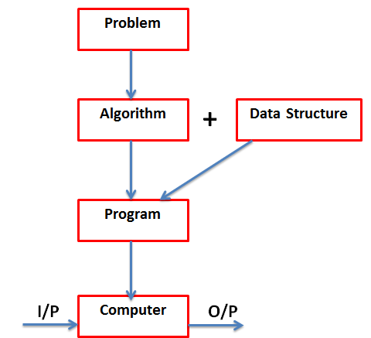
Basic Concept

Slide 5
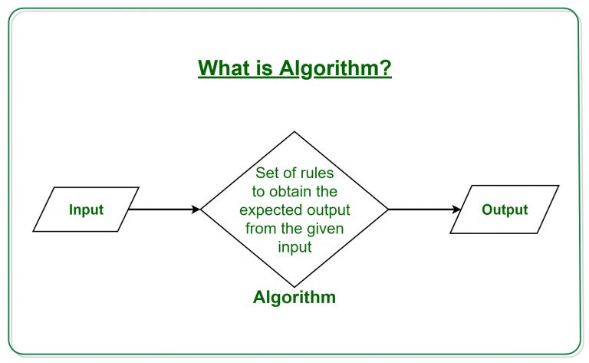
What is Algorithm?
A finite set of instruction that specifies a sequence of operation is to be carried out in order to solve a specific problem or class of problems is called an Algorithm.

Slide 6
Characteristics of an Algorithm
Input − An algorithm should have 0 or more well-defined inputs.
Output − An algorithm should have 1 or more well-defined outputs, and should match the desired output.
Unambiguous/ Definiteness − Algorithm should be clear and unambiguous.
Finiteness − Algorithms must terminate after a finite number of steps.
Feasibility − Should be feasible with the available resources.
Independent − An algorithm should have step-by-step directions, which should be independent of any programming code.

Slide 7
Characteristics of an Algorithm (Contd.)
Some other characteristics are:
Precision
Correctness
Fitness
Determination

Slide 8
Common term used in Algorithm
Variable: specific location in computer memory used to store one and only one value.
Datatypes: the type of data a variable can hold
Statement : line of code

Slide 9
Algorithm Specification
Algorithm can be described in three ways:
1) Natural language like English
2) Graphic representation called flowchart
3) Pseudo-code Method

Slide 10
Need of Algorithm
1. To understand the basic idea of the problem.
2. To find an approach to solve the problem.
3. To improve the efficiency of existing techniques.
4. To understand the basic principles of designing the algorithms.
5. To compare the performance of the algorithm with respect to other techniques.
6. It is the best method of description without describing the implementation detail.
7. The Algorithm gives a clear description of requirements and goal of the problem to the designer.

Slide 11
Need of Algorithm (CONTD…)
8. A good design can produce a good solution.
9. To understand the flow of the problem.
10. To measure the behavior (or performance) of the methods in all cases (best cases, worst cases, average cases)
11. With the help of an algorithm, we can also identify the resources (memory, input-output) cycles required by the algorithm.
12. With the help of algorithm, we convert art into a science.
13. To understand the principle of designing.
14. We can measure and analyze the complexity (time and space) of the problems concerning input size without implementing and running it; it will reduce the cost of design.

Slide 12
Algorithm vs Program
A finite set of instructions that specifies a sequence of operations to be carried out to solve a specific problem of a class of problem is called an algorithm.
Program doesn't have to satisfy the finiteness condition. For example, we can think of an operating system that continues in a "wait" loop until more jobs are entered. Such a program doesn't terminate unless the system crashes.

Slide 13
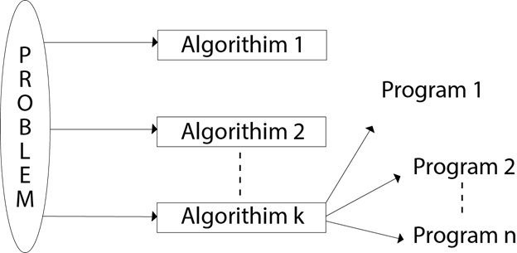

Slide 14
Issues or study of Algorithm
How to device or design an algorithm --> creating and algorithm.
How to express an algorithm --> definiteness.
How to analysis an algorithm --> time and space complexity.
How to validate an algorithm --> fitness.
Testing the algorithm --> checking for error.

Slide 15
REFERENCES
Text books:
Cormen, Leiserson, Rivest, Stein, “Introduction to Algorithms”, Prentice Hall of India, 3rd edition 2012. problem, Graph coloring.
Horowitz, Sahni and Rajasekaran, “Fundamentals of ComputerAlgorithms”, University Press (India), 2nd edition
Websites:
https://www.geeksforgeeks.org/introduction-to-algorithms/
https://www.tutorialspoint.com/design_and_analysis_of_algorithms/index.htm

Slide 16
Summary
Introduction to Algorithm
  Characteristic of algorithm
  Needs and specification of algorithm

Slide 17
THANK YOU

